Slide 1
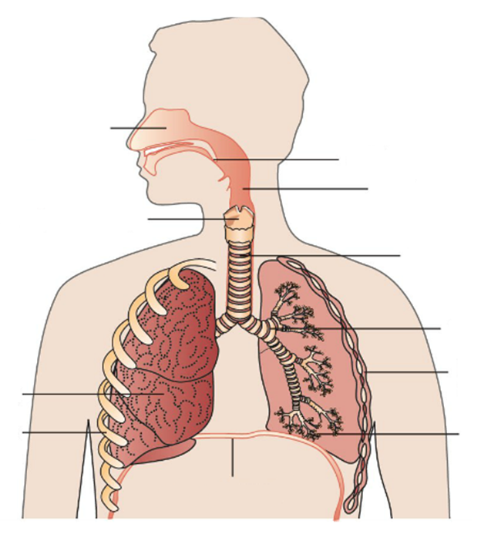
Daily Review
The Respiratory System
Match the organs below to the correct letter in the diagram of the respiratory system
Bronchus
Nasal cavity
Pharynx
Diaphragm
Trachea
Alveoli
Rib
A
Epiglottis
B
Larynx
C
D
Intercostal Muscles
Lung
E
F
G

Slide 2
Daily Review
The Organs of the Respiratory System
The pharynx, trachea and bronchi have a similar function.
Think, Pair, Share: What is the function of these organs in the respiratory system?
Nasal cavity
Epiglottis
Pharynx
Larynx
Trachea
Bronchus
Intercostal Muscles
Lung
Ribs
Alveoli
Diaphragm

Slide 3
Daily Review
Breathing
Breathing occurs when the diaphragm and intercostal muscles work together
When breathing in, the muscles contract to expand the chest and draw air into the lungs
When breathing out, the muscles relax, the chest deflates and pushes air out of the lungs
Which muscles are involve in breathing?
When you breathe in, do the muscles contract or relax?

Slide 4
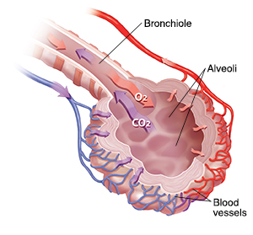
Daily Review
Gas Exchange in the Alveoli
The alveoli exchange oxygen and carbon dioxide
They are a small sac on the end of a bronchiole and are surrounded by a mesh of tiny blood vessels
Oxygen moves into the blood and carbon dioxide moves out of the blood
Describe the structure of an alveolus.
Describe what happens in an alveolus.

Slide 5
Musculoskeletal System: Bones

Slide 6
Learning Objectives
CFU
What are we going to learn?
Describe the structure of bones
Identify major bones in the human body
Describe the function of the axial and appendicular skeleton
Activate Prior Knowledge
The skeleton is the internal framework of the body. An adult human has 206 bones.
Think, Pair, Whiteboard, Share: List the names of as many bones as you can.

Slide 7
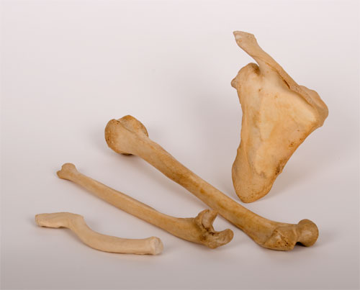
Concept Development
CFU 1
What are the three characteristics of bones?
Vocabulary
Characteristic: Feature or quality Elastic: able to return to its normal shape after being stretched or compressed
Characteristics of Bones
Bones need to be strong so they don’t snap under normal activity.
They must be light so they can be moved by muscles.
They must be elastic so they can be compressed and stretched without breaking.
CFU 2
Why do bones need to be elastic?
CFU 3
Which characteristic of bones allows them to be moved easily?

Slide 8
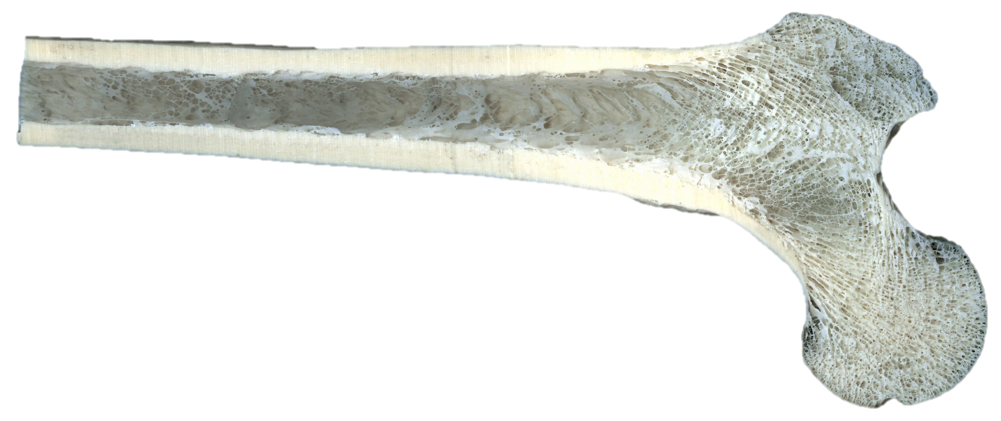
Concept Development
CFU 1
What are the two types of bone tissue?
Vocabulary
Porous: has many holes
Structure of Bones
There are two types of bone tissue:
Compact bone is dense and heavy. This gives bone its strength.
Spongy bone is porous and looks like honeycomb. The spaces in the bone make it light.
Fun Fact
The gaps in spongy bone are filled with bone marrow, a soft, jelly-like substance. This is where red blood cells are made.
CFU 32
Which label represents spongy bone and which represents compact bone? Explain your choice.
B
A

Slide 9
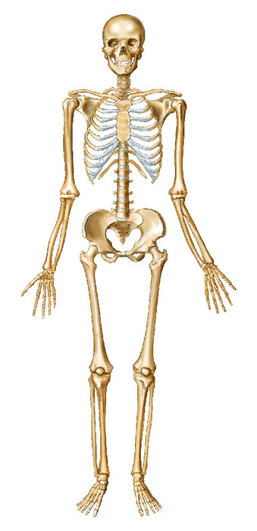
Concept Development
Skull
Clavicle
Major Bones in the Human Body
Ribs
CFU 1
Which three bones make up the human arm?
Humerus
Radius
CFU 2
Which bones protect the lungs and heart?
Ulna
CFU 3
What organ does the skull protect?

Slide 10
Concept Development
Major Bones in the Human Body
CFU 1
Which bones make up the human leg?
Vertebrae
CFU 2
Which organ do the vertebrae protect?
Pelvis
Femur
CFU 3
What is the common name for the patella?
Patella
Tibia
Fibula

Slide 11
Concept Development
CFU 1
What are the two parts of the skeleton?
Vocabulary
Vital organ: An organ you cannot live without eg. brain, lungs, heart
Skull
Clavicle
Axial Skeleton and Appendicular Skeleton
The skeleton can be divided into two general parts:
The axial skeleton – bones that protect vital organs
The appendicular skeleton – bones that allow movement
Ribs
Humerus
Vertebrae
Radius
Pelvis
Ulna
Femur
CFU 2
How is the axial skeleton different to the appendicular skeleton?
CFU 3
Which part of the skeleton does the skull belong to? Explain your choice.
Patella
Tibia
Fibula

Slide 12
Skill Development/Guided Practice
Vocabulary
Vital organ: An organ you cannot live without eg. brain, lungs, heart
Describing parts of the skeleton
1. Does the bone protects a vital organ? = axial skeleton 2. Does the bone allows movement? = appendicular skeleton
Ribs
Describe the function of the ribs.
The ribs protect the lungs and heart, so they are part of the axial skeleton.

Slide 13
Skill Development/Guided Practice
Vocabulary
Vital organ: An organ you cannot live without eg. brain, lungs, heart
Describing parts of the skeleton
1. Does the bone protects a vital organ? = axial skeleton 2. Does the bone allows movement? = appendicular skeleton
Describe the function of the femur.
The femur allows the body to move, so it is part of the appendicular skeleton.
Femur

Slide 14
Skill Development/Guided Practice
Vocabulary
Vital organ: An organ you cannot live without eg. brain, lungs, heart
Describing parts of the skeleton
1. Does the bone protects a vital organ? = axial skeleton 2. Does the bone allows movement? = appendicular skeleton
Radius
Describe the function of the radius.
The radius allows the body to move, so it is part of the appendicular skeleton.

Slide 15
Skill Development/Guided Practice
Vocabulary
Vital organ: An organ you cannot live without eg. brain, lungs, heart
Skull
Describing parts of the skeleton
1. Does the bone protects a vital organ? = axial skeleton 2. Does the bone allows movement? = appendicular skeleton
Describe the function of the skull.
The skull protects the brain, so it is part of the axial skeleton.

Slide 16
Skill Development/Guided Practice
Vocabulary
Vital organ: An organ you cannot live without eg. brain, lungs, heart
Describing parts of the skeleton
1. Does the bone protects a vital organ? = axial skeleton 2. Does the bone allows movement? = appendicular skeleton
Humerus
Describe the function of the humerus.
The humerus allows the body to move, so it is part of the appendicular skeleton.

Slide 17
Skill Development/Guided Practice
Vocabulary
Vital organ: An Organ you cannot live without eg. brain, lungs, heart
Describing parts of the skeleton
1. Does the bone protects a vital organ? = axial skeleton 2. Does the bone allows movement? = appendicular skeleton
Vertebrae
Describe the function of the vertebrae.
The vertebrae protect the spinal cord, so it is part of the axial skeleton.

Slide 18
Relevance
Knowing how organs work together in a system and how the systems interact with each other will help you understand how the body works.
Understanding the structure of the skeletal system will help you understand the function of different bones within the body.

Slide 19
Skill Closure
A
Identify the following bones by letter:
Patella, Humerus, Skull, Vertebrae, Femur, Ribs
B
F
C
Skill Closure
G
D
Describe the function of the tibia (K)
H
E
Skill Closure
I
Describe the function of the skull (A)
J
Describing parts of the skeleton
1. Does the bone protects a vital organ? = axial skeleton 2. Does the bone allows movement? = appendicular skeleton
K
L

Slide 20
Independent Practice
Skull
Collect and complete a hard copy of the skeleton worksheet.
Clavicle
Characteristics of Bones
Bones need to be strong so they don’t snap
They must be light so they can be moved by muscles
They must be elastic so they can be compressed and stretched
Structure of Bones
Compact bone is dense and heavy, for strength.
Spongy bone is porous to make it light.
Axial Skeleton and Appendicular Skeleton
The axial skeleton – bones that protect vital organs
The appendicular skeleton – bones that allow movement
Ribs
Humerus
Vertebrae
Radius
Pelvis
Ulna
Femur
Patella
Tibia
Fibula

